Slide 1
Cloud Data Engineering
Graph Theory

Slide 2
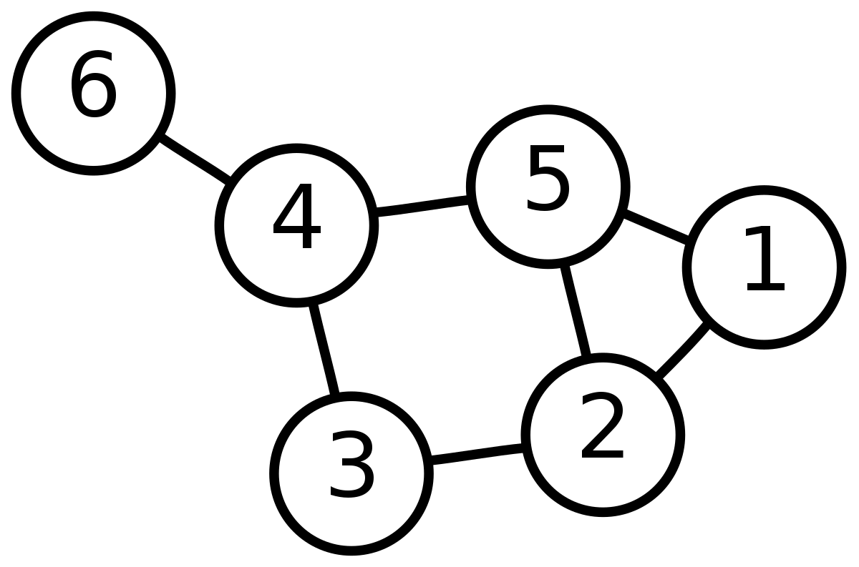

Graph Theory
A graph $G=(V,E)$ consists of two finite sets:
V – the set of vertices
E – the set of edges
For example, in the figure below:
$$V=\left\{1,2,3,4,5,6\right\} \\ E=\{\left(1,2\right), \left(2,3\right), \left(1,5\right)…\}$$

Slide 3
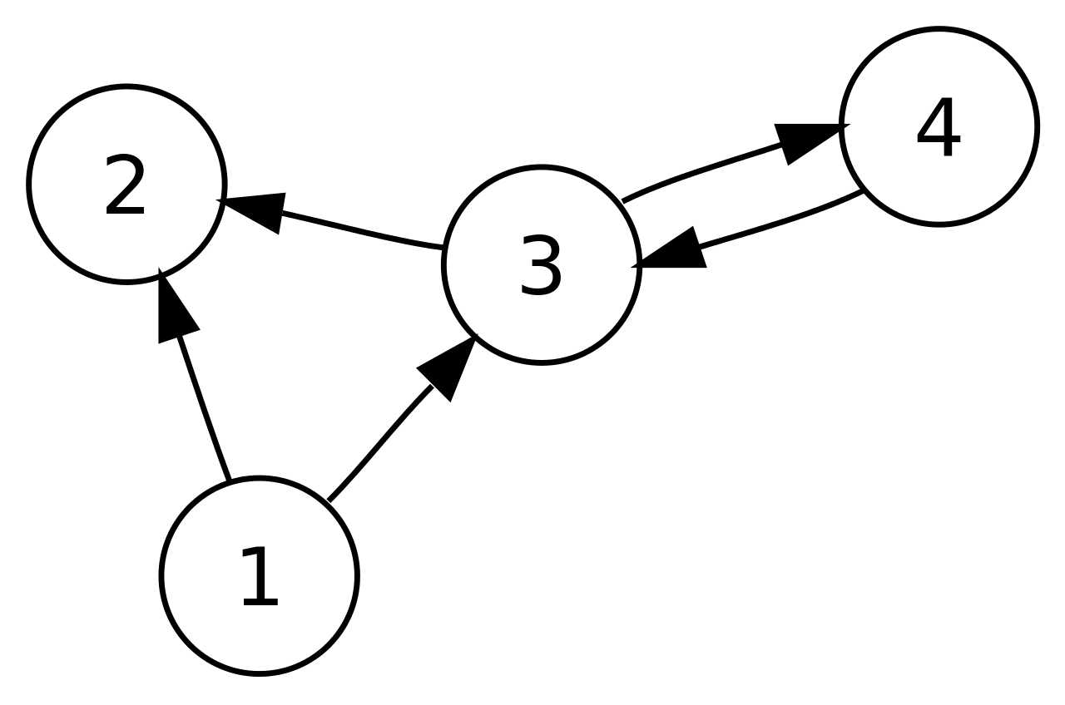
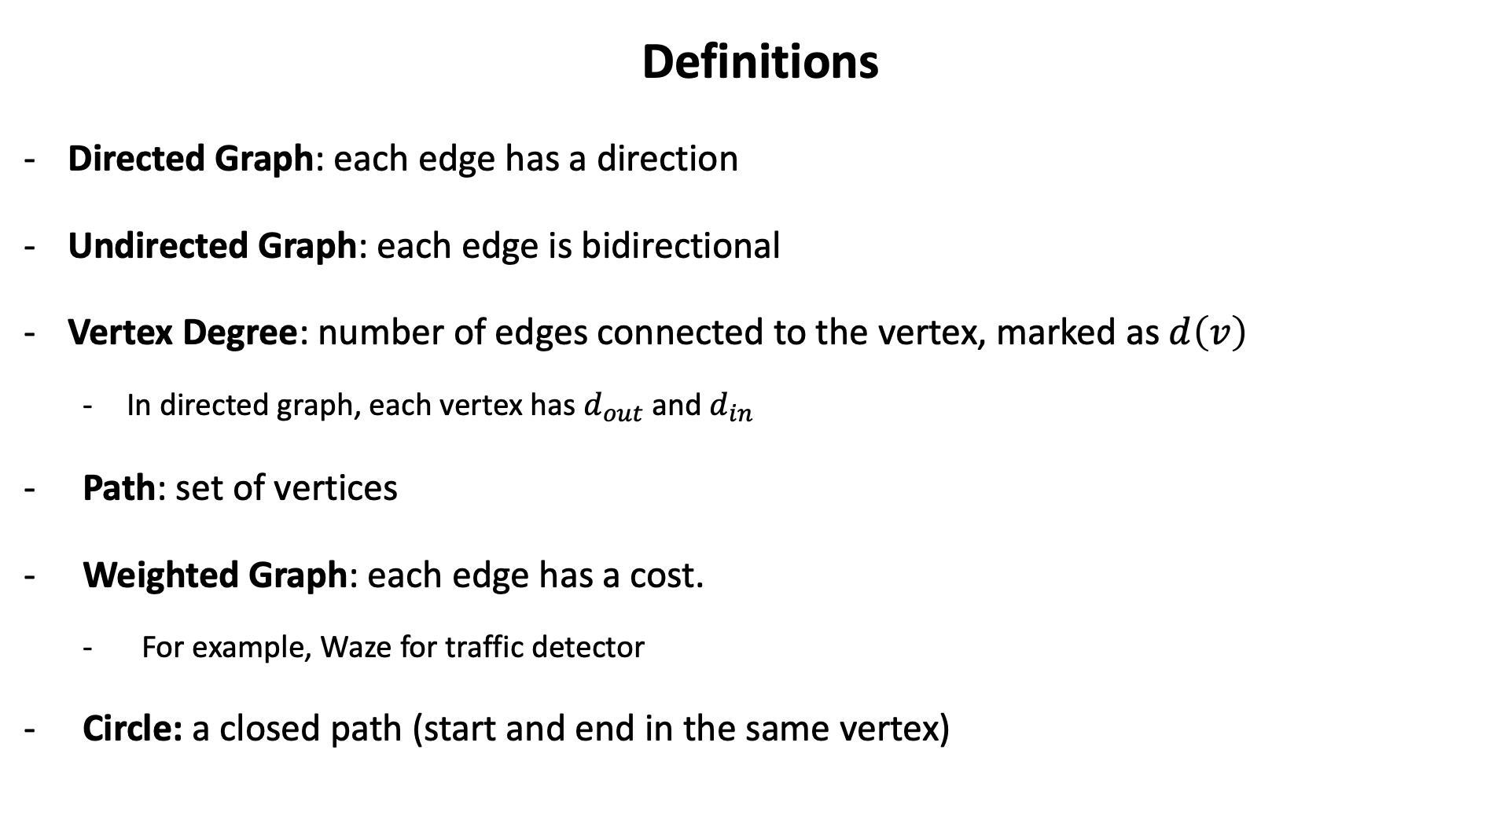
Definitions
Directed Graph: each edge has a direction
Undirected Graph: each edge is bidirectional
Vertex Degree: number of edges connected to the vertex, marked as $d\left(v\right)$
In directed graph, each vertex has $d_{out}$ and $d_{in}$
Path: set of vertices
Weighted Graph: each edge has a cost.
For example, Waze for traffic detector
Circle: a closed path (start and end in the same vertex)

Slide 4
Graphs: Examples
The internet: webpages are represented as nodes and the hyperlinks between those sites are represented as edges.
Social Networks: each person is represented as a vertex, and the edges could represent the friendships between the individuals.

Slide 5
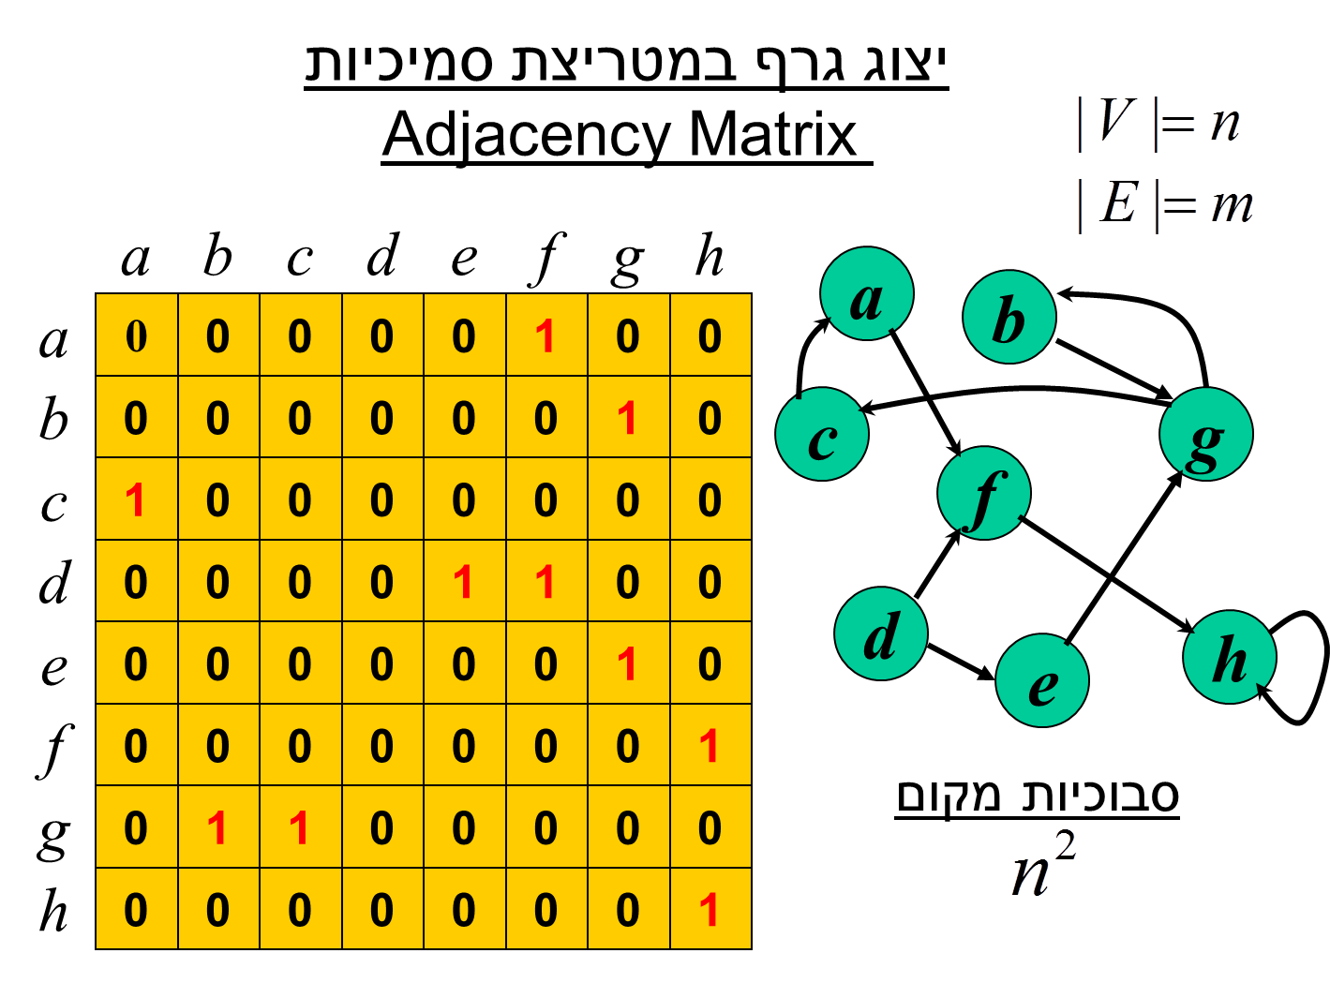

Represent A Graph
Adjacency Matrix: size $O\left({\left|V\right|}^{2}\right)$

Slide 6
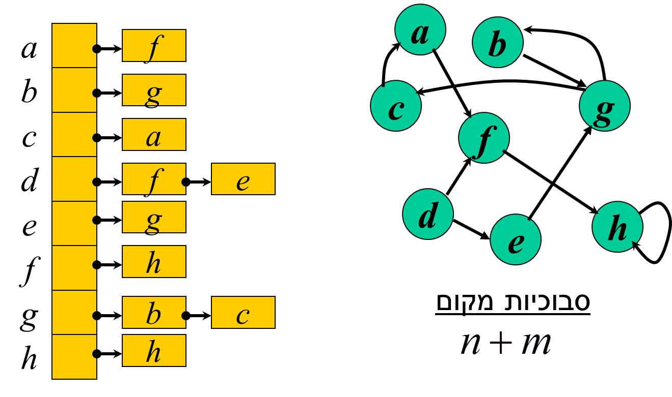

Represent A Graph
Adjacency Lists (Hash Table + Linked List): $O\left(\left|V\right|+|E|\right)$

Slide 7
Graph Class
class Graph:
def __init__(self, dict):
self.dict = dict
def get_vertices(self):
return list(self.dict.keys())
g = Graph(
{"A":["B", "C", "D"],
"B": ["A"],
"C": ["A", "D"]}
)

Slide 8
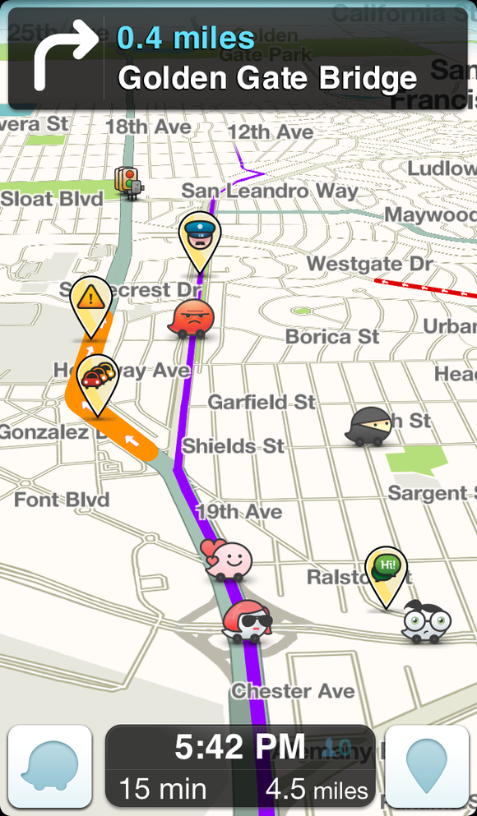
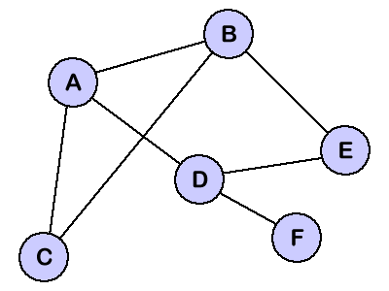
Shortest Path

Slide 9
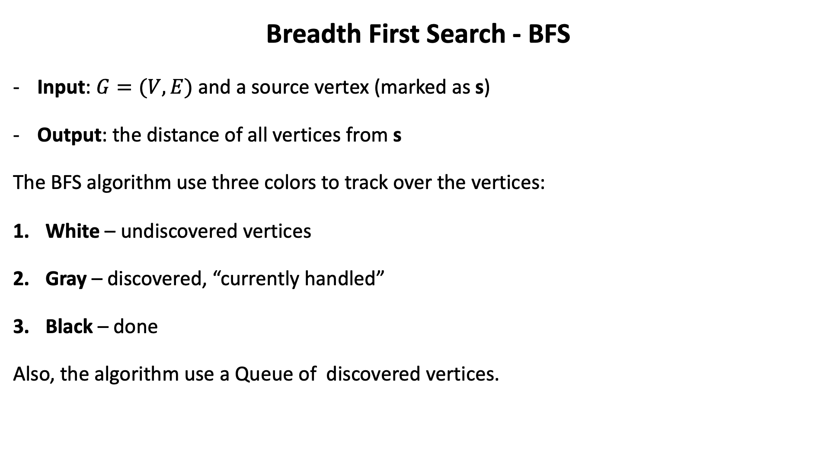
Breadth First Search - BFS
Input: $G=(V,E)$ and a source vertex (marked as s)
Output: the distance of all vertices from s
The BFS algorithm use three colors to track over the vertices:
White – undiscovered vertices
Gray – discovered, “currently handled”
Black – done
Also, the algorithm use a Queue of discovered vertices.

Slide 10
BFS Example
r
s
t
u
∞
0
∞
∞
∞
∞
∞
∞
v
w
x
y
Q: s
0

Slide 11
BFS Example
r
s
t
u
1
0
∞
∞
∞
1
∞
∞
v
w
x
y
Q: w r
1 1

Slide 12
BFS Example
r
s
t
u
1
0
2
∞
∞
1
2
∞
v
w
x
y
Q: r t x
1 2 2

Slide 13
BFS Example
r
s
t
u
1
0
2
∞
2
1
2
∞
v
w
x
y
Q: t x v
2 2 2

Slide 14
BFS Example
r
s
t
u
1
0
2
3
2
1
2
∞
v
w
x
y
Q: x v u
2 2 3

Slide 15
BFS Example
r
s
t
u
1
0
2
3
2
1
2
3
v
w
x
y
Q: v u y
2 3 3

Slide 16
BFS Example
r
s
t
u
1
0
2
3
2
1
2
3
v
w
x
y
Q: u y
3 3

Slide 17
BFS Example
r
s
t
u
1
0
2
3
2
1
2
3
v
w
x
y
Q: y
3

Slide 18
BFS Example
r
s
t
u
1
0
2
3
2
1
2
3
v
w
x
y
Q: ∅

Slide 19
Output – BFS Tree
r
s
t
u
1
0
2
3
2
1
2
3
v
w
x
y

Slide 20

BFS
from collections import deque
class Graph:
…
def bfs(self, start, goal):
x = (start, [start])
queue = deque()
queue.append(x)
results = []
while queue:
(vertex, path) = queue.popleft()
for next in set(self.dict[vertex]) - set(path):
if next == goal:
results.append(path + [next])
else:
queue.append((next, path + [next]))
return results

Slide 21
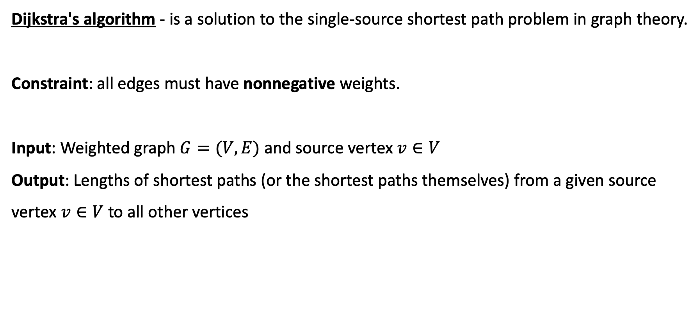
Dijkstra's algorithm
Dijkstra's algorithm - is a solution to the single-source shortest path problem in graph theory.
Constraint: all edges must have nonnegative weights.
Input: Weighted graph $G=(V,E)$ and source vertex $v∈V$
Output: Lengths of shortest paths (or the shortest paths themselves) from a given source vertex $v∈V$ to all other vertices

Slide 22
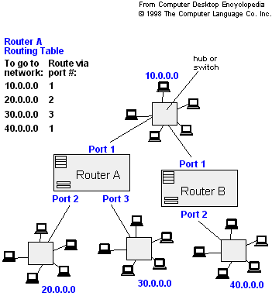
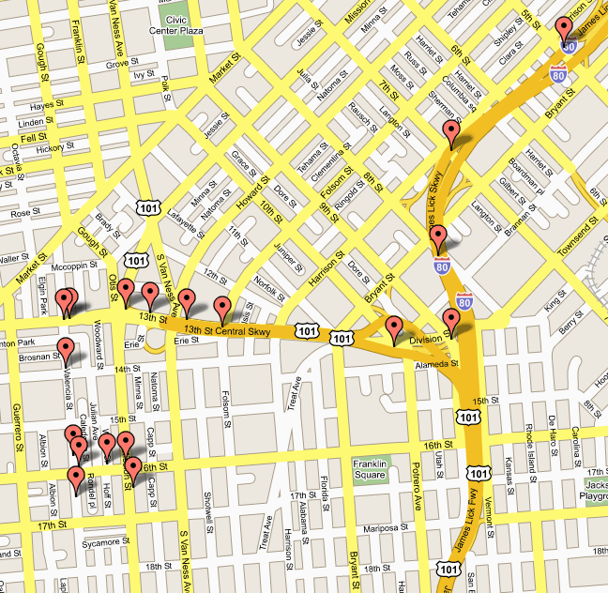
Applications of Dijkstra's Algorithm

Slide 23
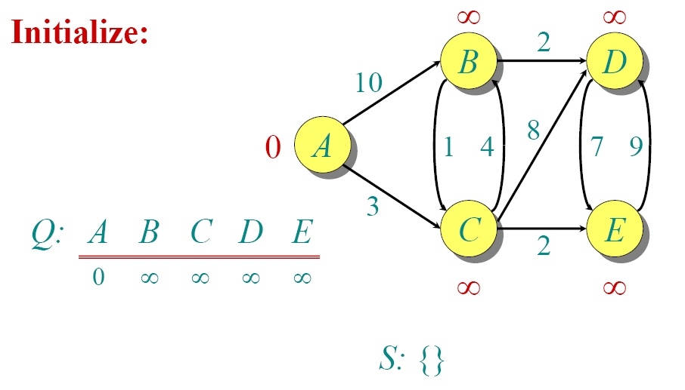
Dijkstra - Example

Slide 24
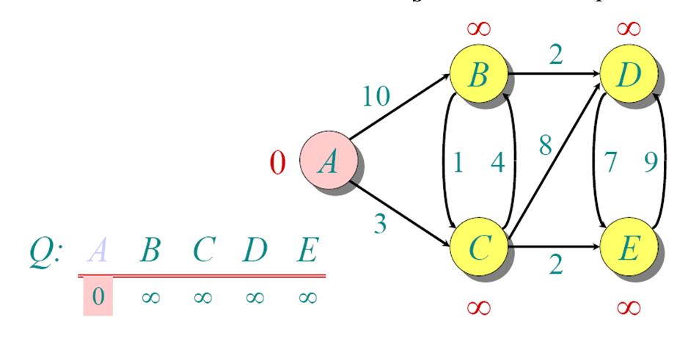
Dijkstra - Example

Slide 25
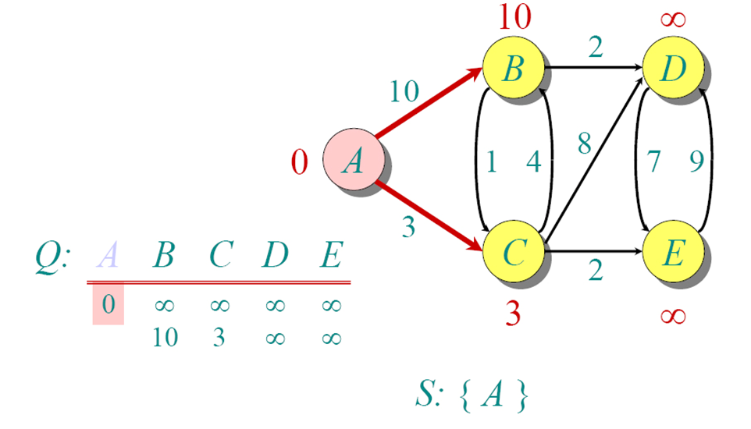
Dijkstra - Example

Slide 26
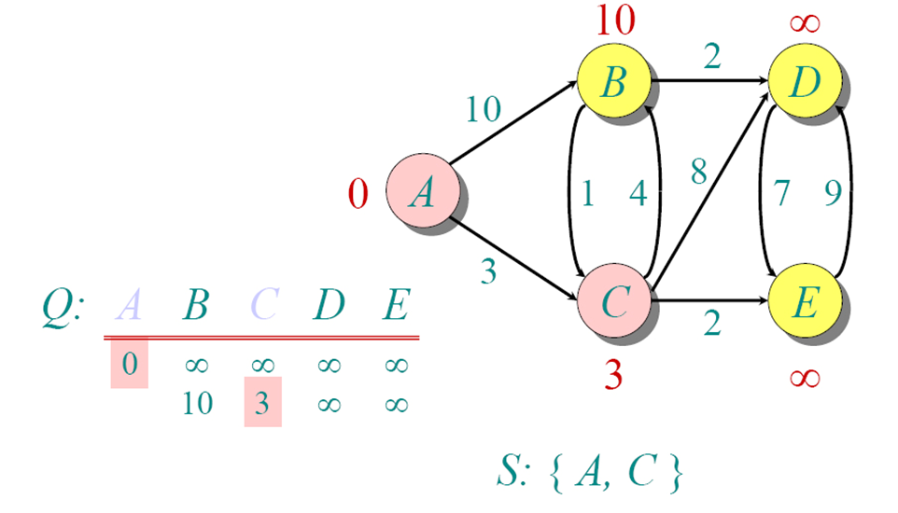
Dijkstra - Example

Slide 27
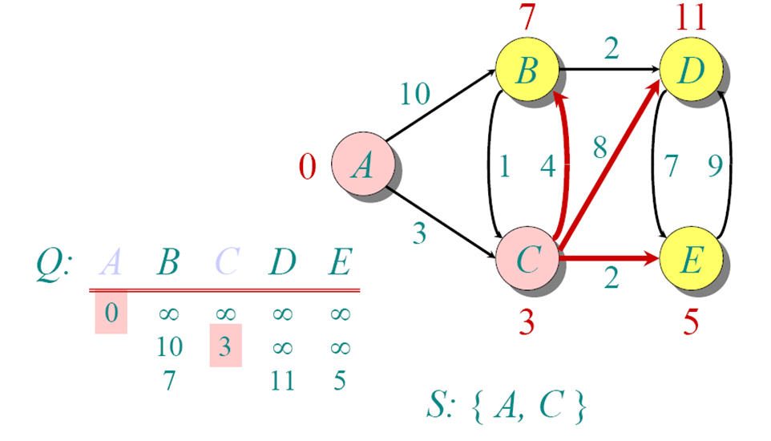
Dijkstra - Example

Slide 28
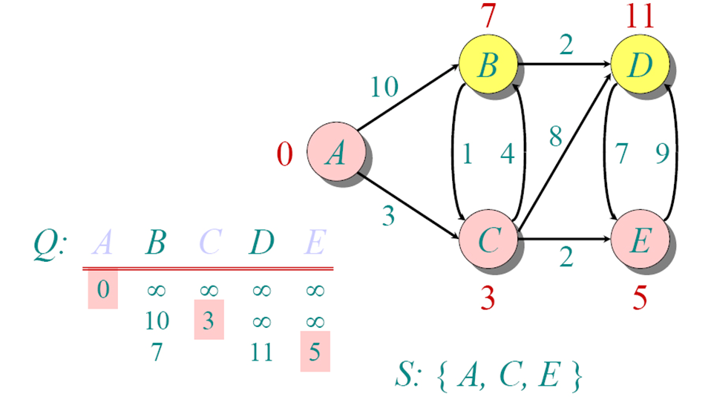
Dijkstra - Example

Slide 29
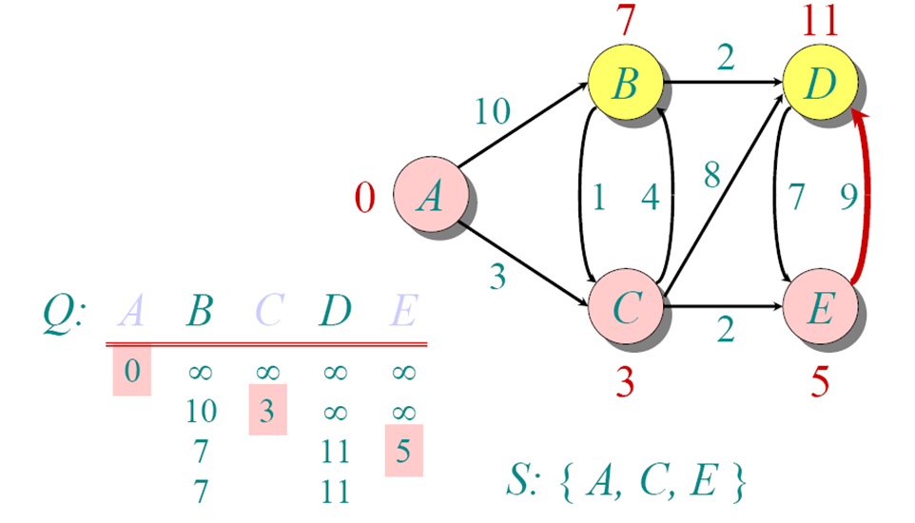
Dijkstra - Example

Slide 30
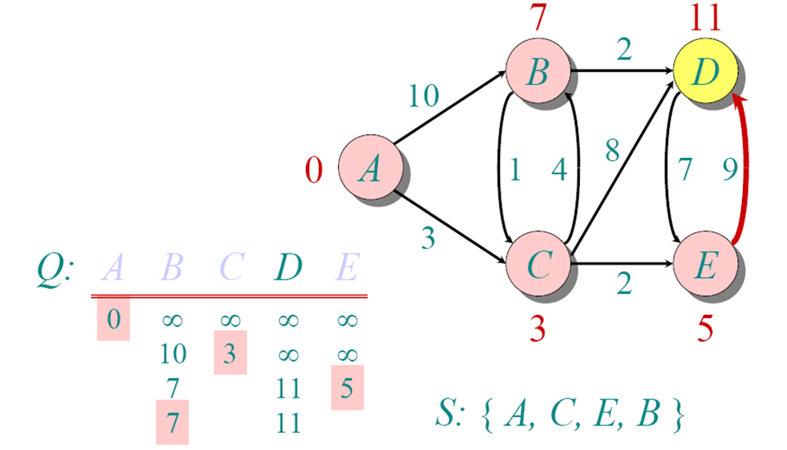
Dijkstra - Example

Slide 31
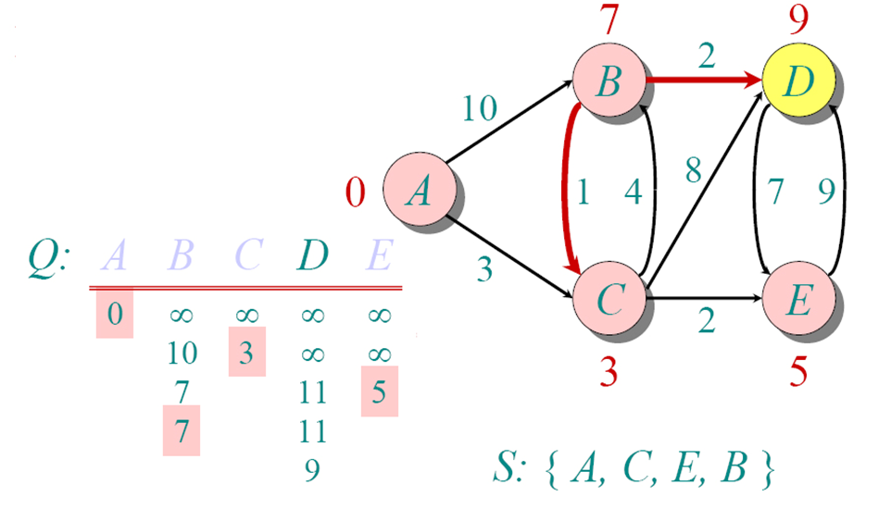
Dijkstra - Example

Slide 32
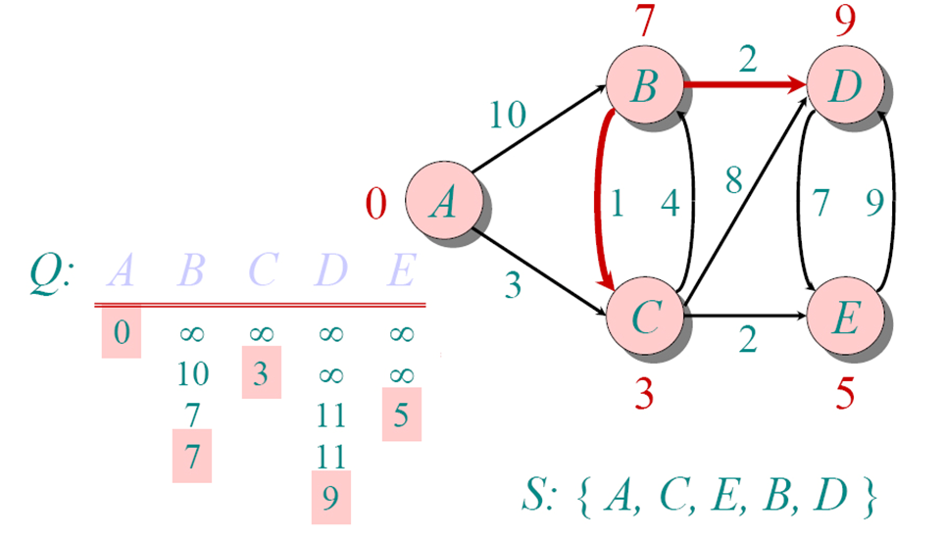
Dijkstra - Example

Slide 33
Dijkstra's algorithm
dist[s] ←0 (distance to source vertex is zero) for all v ∈ V–{s} do dist[v] ←∞ (set all other distances to infinity) S←∅ (S, the set of visited vertices is initially empty) Q←V (Q, the queue initially contains all vertices) while Q ≠∅ (while the queue is not empty) do u ← mindistance(Q,dist) (select the element of Q with the min. distance) S←S∪{u} (add u to list of visited vertices) for all v ∈ neighbors[u] do if dist[v] > dist[u] + w(u, v) (if new shortest path found) then d[v] ←d[u] + w(u, v) (set new value of shortest path)
(if desired, add traceback code)
return dist

Slide 34
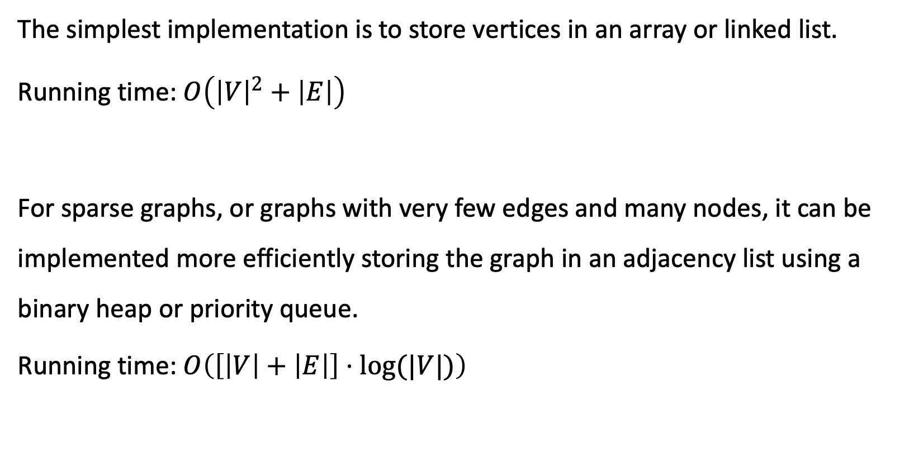
Running Times
The simplest implementation is to store vertices in an array or linked list.
Running time: $O\left({\left|V\right|}^{2}+\left|E\right|\right)$
For sparse graphs, or graphs with very few edges and many nodes, it can be implemented more efficiently storing the graph in an adjacency list using a binary heap or priority queue.
Running time: $O\left(\left[\left|V\right|+\left|E\right|\right]⋅log(|V|)\right)$

Slide 35
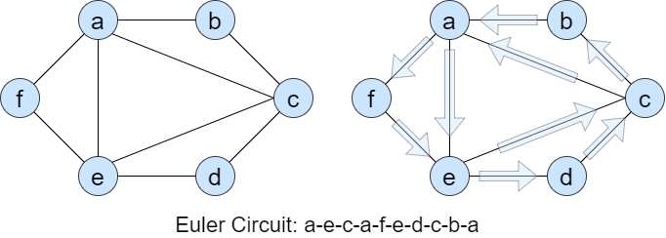
Euler Tour and Cycle
Eulerian Cycle is a path in graph that:
Visits every edge exactly once
Start and end in the same vertex

Slide 36
Applications
Jobs scheduling
Matching: jobs and processors

Slide 37
Euler Cycle – How To?
Suppose that a graph has an Euler cycle.
For every vertex (v), each edge having v as an endpoint shows up exactly once in the cycle.

Slide 38
Euler Cycle – How To?
The cycle enters v the same number of times that it leaves v (x times), so v has degree 2x.
That is, v must be an even degree.

Slide 39
Claim
A graph G has Euler cycle if and only if:
G is connected
Every vertex has even degree

Slide 40
Thank You! Questions?

